Slide 1
DBMS PROJECT Review 2 Flora and Fauna Species in a Wildlife Reserve Ishita Jaju 16BCE1059 Pooja Uplanchiwar 16BCE1030 Kartikay Kaul 16BCE1057

Slide 2
Admin Access
New Species
Updating Records
Feedback
Flora
Fauna
Population Updation
Sick Animal Records
Mutations
Expert Review
Bird Watchers
General Public
Staff Record
Rangers
MODULES AND DESCRIPTION

Slide 3
FRONT END
Website name: Wild and Free

Slide 4
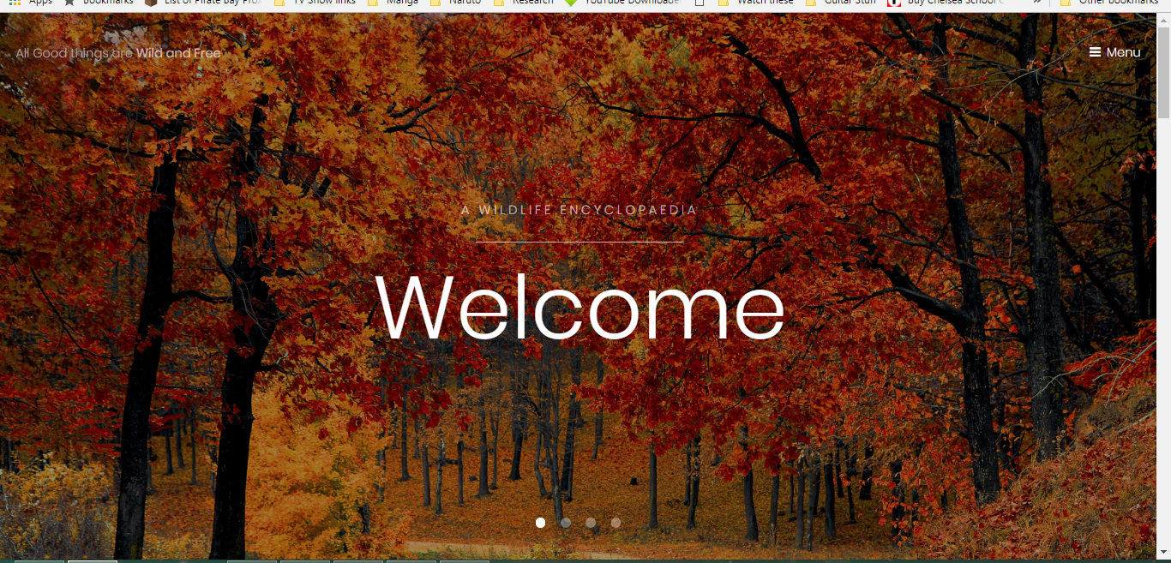
Home page

Slide 5
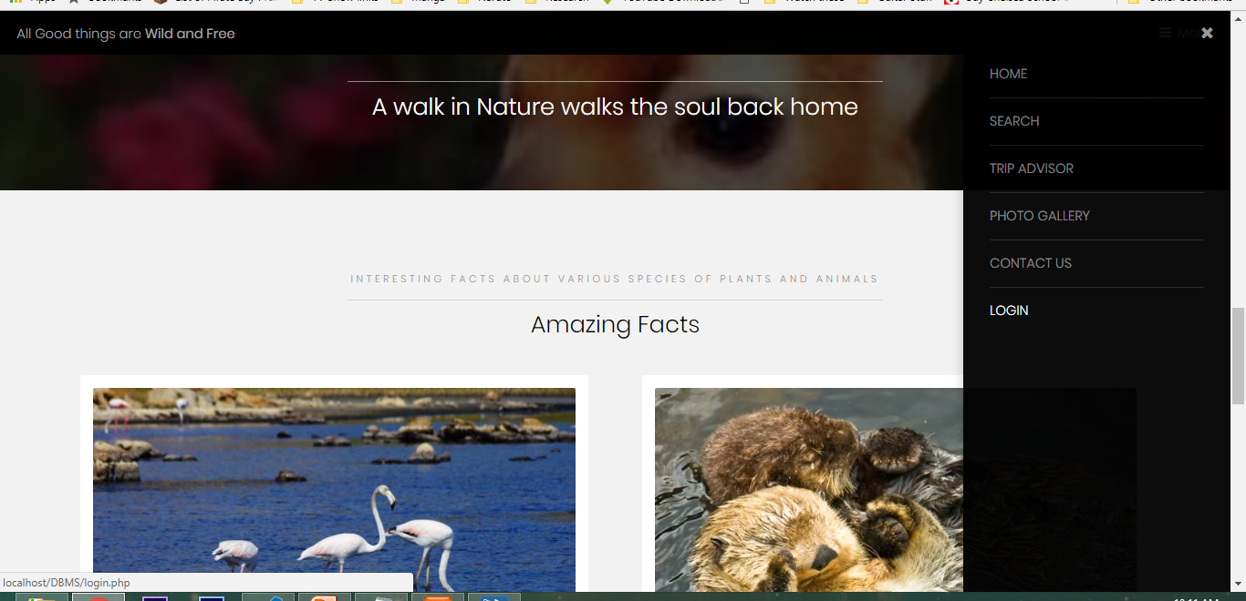

Slide 6
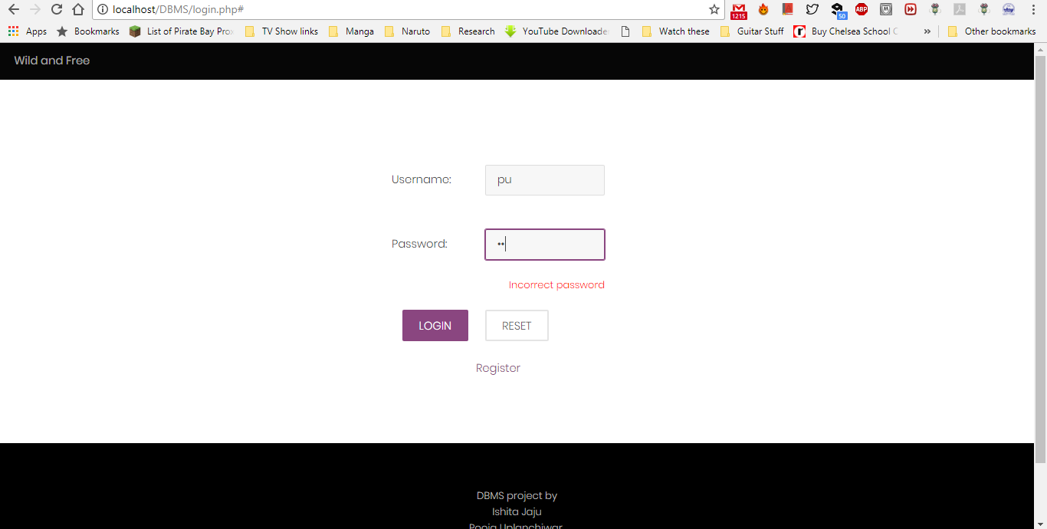
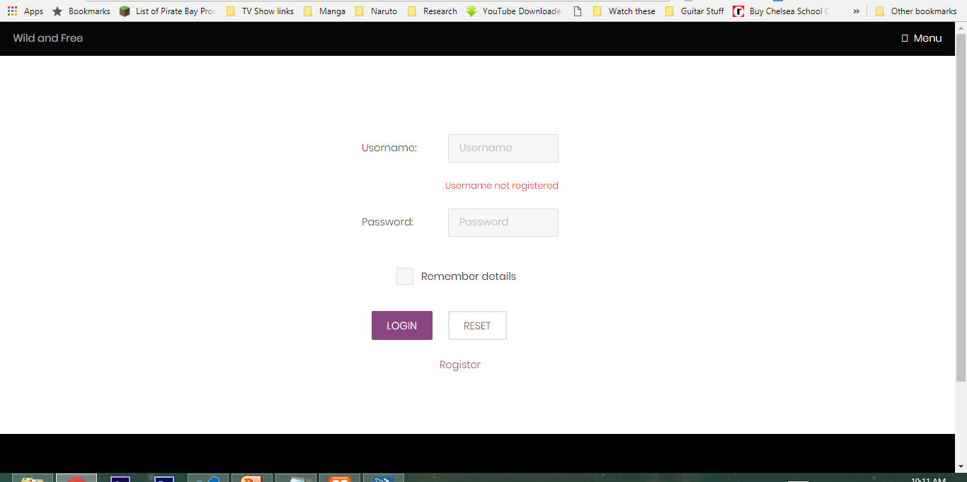
LOGIN

Slide 7
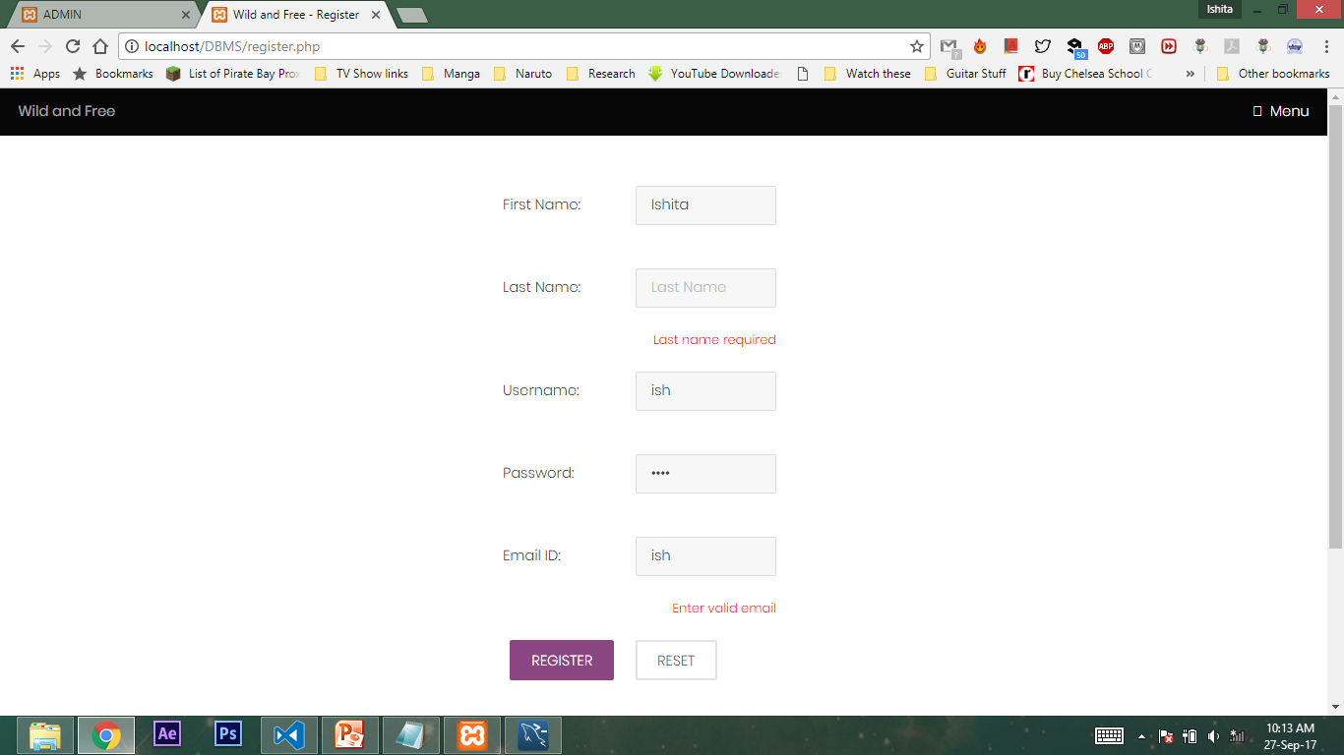
Register Form

Slide 8
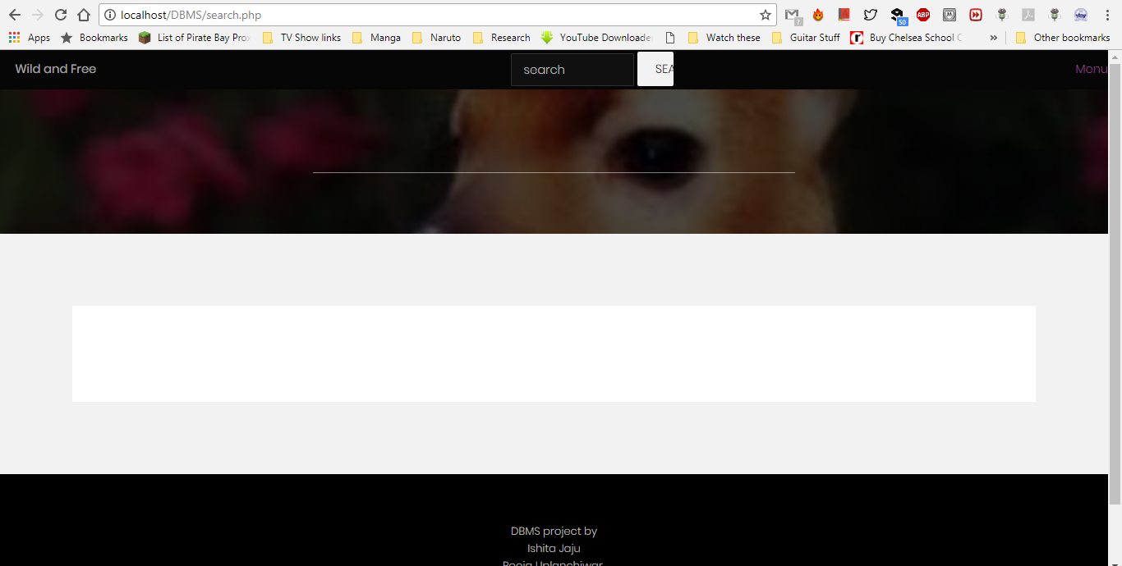
Search Bar

Slide 9
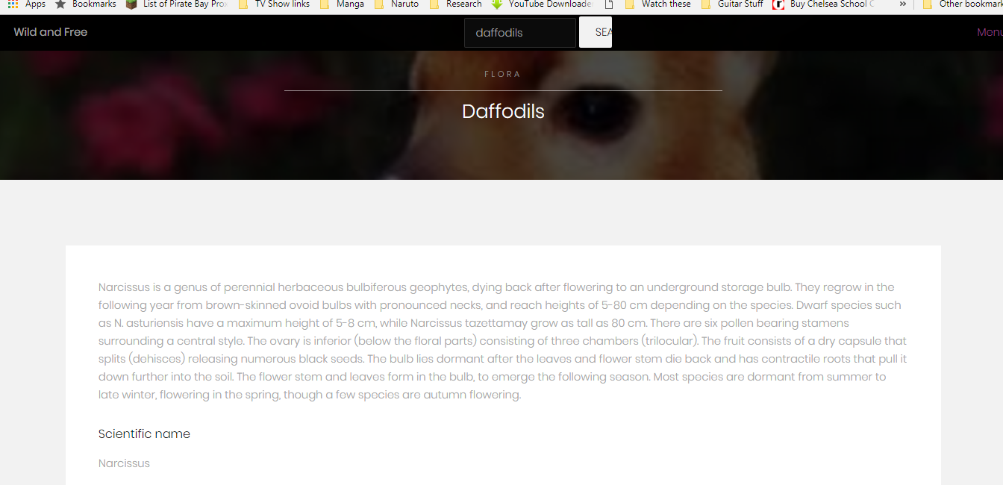

Slide 10
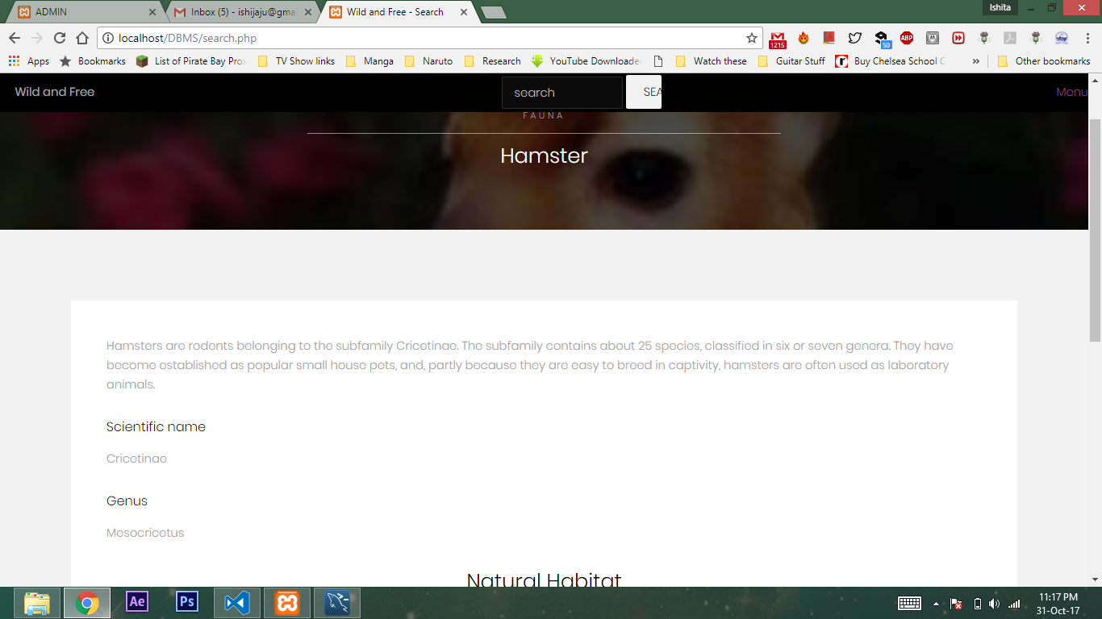

Slide 11
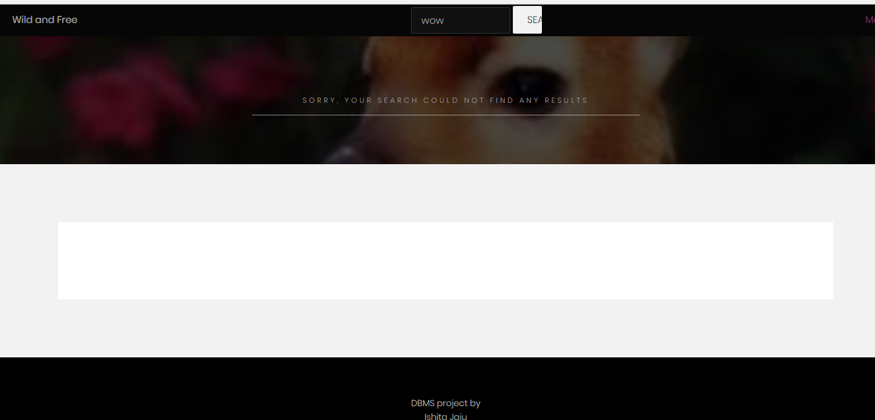

Slide 12
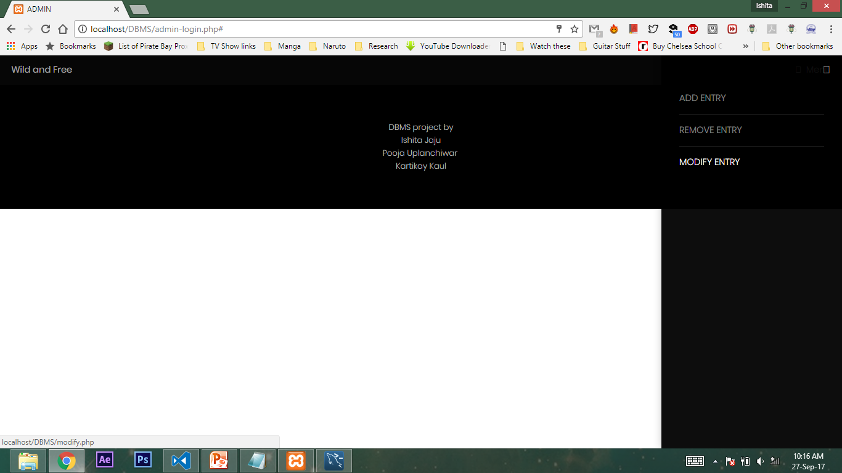
ADMIN ACCESS

Slide 13
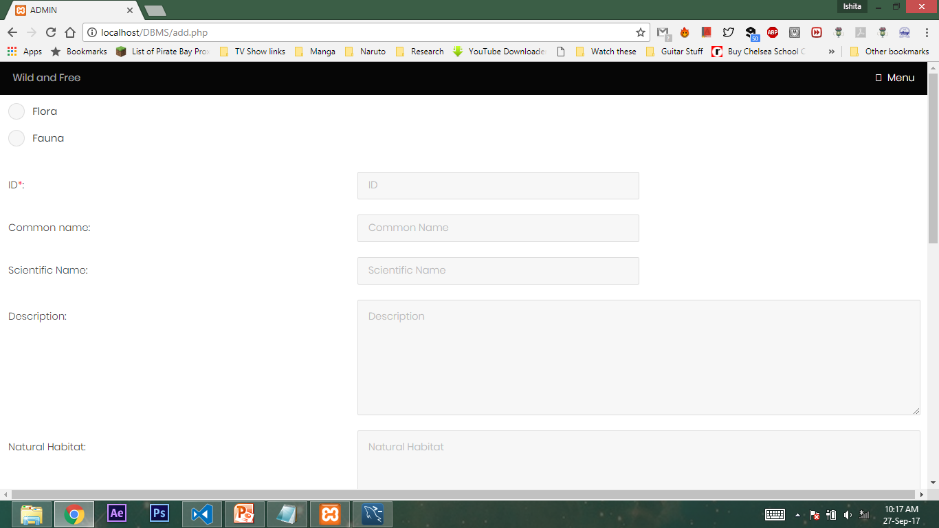

Slide 14
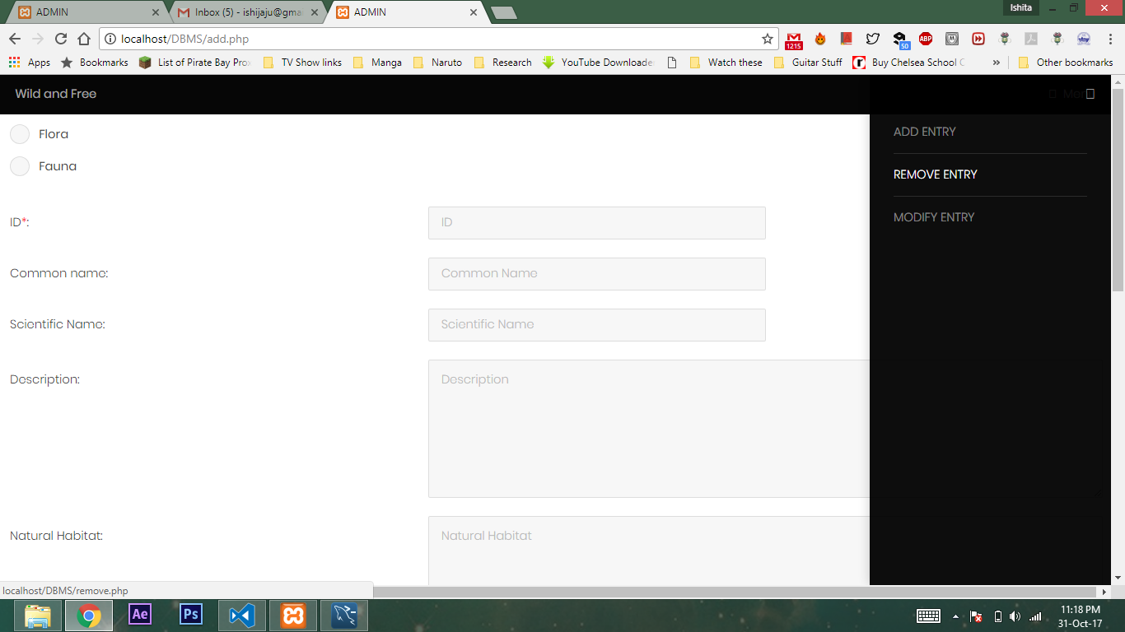

Slide 15
Back End
Table names: User, Species

Slide 16
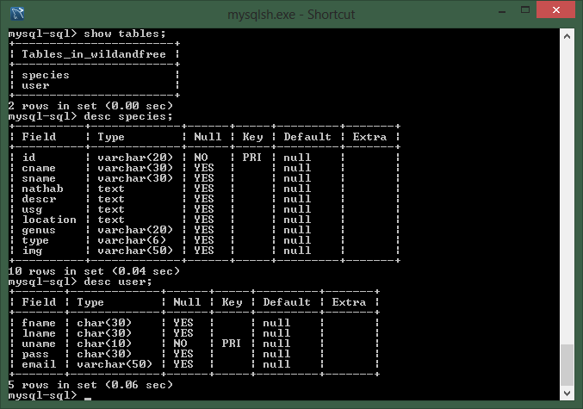
TABLE DESIGNS

